Slide 1
Color scheme
Primary color. Use the two lightest only unless more shades are necessary
Secondary color.
Shades of grey
Red (third color)
Use only when
More than two colors are needed
Use the Green/Red meaning for Good/Bad
Green (fourth color)

Slide 2
Approximate page width
13,58 cm
384 pt
Approximate page landscape
23,07 cm
654 pt

Slide 3

Evaluation objectives
(simplified)
Design report
metric { name : Delay
measure : mean }
conv. { expected : True
measure : mean }
KPI { percentile : 25th perc.
confidence : 75% }
score { percentile : 75th perc.
confidence : 75% }
(simplified)
metric { name : Throughput
measure : median }
conv. { expected : True
confidence : 95%
tolerance : 5% }
KPI { percentile : 25th perc.
confidence : 75% }
var. { percentile : 75th perc.
score confidence : 75% }
§4.1
§4.2
§4.3
runtime : 30s has_converged : True
#runs : 5 span : anytime
#series : 3
Run
Series
Sequel
Design
Is runtime long enough? ‘has_converged’
How many runs? ‘#runs’
How many series? ‘#series’
When to run? ‘span’
Performance report
Data collection
Analysis
(simplified)
Compute metrics
Compute
KPIs
Compute variability score
KPI [ 111.8, 112.5,
111.9.45, 110.6,
111.0 ]
var. score 1.89 Mbit/s
Delay
Throughput

Slide 4
Real-time
System Designs
DRP Chapter 4
TTW Chapter 5
Tools and Methods
Baloo Chapter 3
TriScale Chapter 2
Low-Power Wireless Networking
Networking in General

Slide 5
Real-time
System Designs
DRP Chapter 4
TTW Chapter 5
Tools and Methods
Baloo Chapter 3
TriScale Chapter 2
Low-Power Wireless Networking
Networking in General

Slide 6
Real-time
System Designs
DRP Chapter 4
TTW Chapter 5
Tools and Methods
Baloo Chapter 3
TriScale Chapter 2
Low-Power Wireless Networking
Networking in General

Slide 7
Real-time
System Designs
DRP Chapter 4
TTW Chapter 5
Tools and Methods
Baloo Chapter 3
TriScale Chapter 2
Low-Power Wireless Networking
Networking in General

Slide 8
Real-time
System Designs
DRP Chapter 4
TTW Chapter 5
Tools and Methods
Baloo Chapter 3
TriScale Chapter 2
Low-Power Wireless Networking
Networking in General

Slide 9
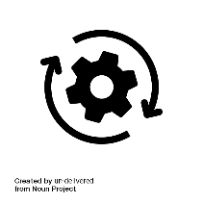

Controller
Sensor
Actuator
End-to-end performance guarantees
Notes:
NEED1
Now, I am not here to talk about emails, but CPS.
CPS is somewhat similar
-> Objects or devices rather than people
-> Distributed, heterogeneous components, that interact with each other
Most importantly: value is in the E2E performance!
-> Not just good sensing
-> Not just transmitting the info
→ The whole chain! And in most cases, in a timely manner

Slide 10
A
B

Slide 11
A
B

Slide 12
A
B

Slide 13
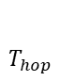

Initiator
Tx
Rx
Tx
1-hop receivers
Rx
Tx
Rx
Tx
2-hop receivers
Rx
Tx
Rx
Tx
3-hop receivers
$$T_{hop}$$
Rx
Tx
Rx
Tx
time
$$T_{flood}$$

Slide 14
Rounds
k
sleep
k+1
time
Slots
N₁
N₂
…
N_{B}
N₂
N_{B}
Glossy floods
N₁

Slide 15
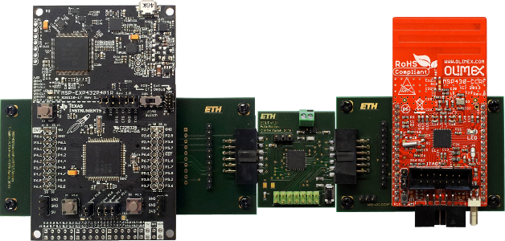


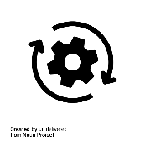
Application Processor (AP)
Bolt API
Bolt API
Communication Processor (CP)
flush
read
write
…
…
Receive Buffer
flush
read
write
…
…
Receive Buffer

Slide 16
Distributed Real-time Protocol (DRP)
LWB*
Glossy
AP
CP
Multi-hop Wireless Network
CP
AP
Time-Triggered Wireless (TTW)
TTnet
Glossy
AP
CP
Multi-hop Wireless Network
CP
AP
Data Link
Network
Scheduler

Slide 17
DRP
Blink
Host
Multi-hop Wireless Network
CP
CP
CP
AP
AP
AP
…

Slide 18
Application Processor (AP)
Bolt API
Bolt API
Communication Processor (CP)
flush
read
write
…
…
Receive Buffer
flush
read
write
…
…
Receive Buffer

Slide 19
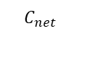

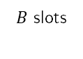
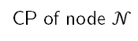
$$T_{net}$$
CP of node 1
CP of node 2
…
$$C_{net}$$
$B$ slots
CP of node $𝒩$
…
time

Slide 20
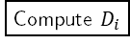
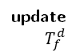
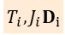
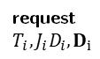


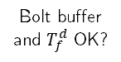
end-to-end latency $≤ D_{i}$
$$f(T_{f}^{s},D_{i})$$
$$g(T_{f}^{d})$$
AP
CP
Blink
CP
AP
Packet flow
$$T_{i}, J_{i}D_{i}$$
Admission Tests
request
$T_{i}, J_{i}D_{i}, D_{i}$
Compute $D_{i}$
Bolt buffer and local memory OK?
YES
Network schedule OK?
YES
Local memory OK?
YES
Bolt buffer
and $T_{f}^{d}$ OK?
YES
NO
NO
NO
NO
Abort
Abort
Abort
Abort
Abort
nack
nack
nack
nack
update $T_{f}^{d}$
Register flow and update schedule
ack
Register flow
ack
Register flow and update schedule
ack
Register flow
ack
Register flow and update schedule
Registration Scheme

Slide 21
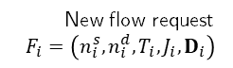
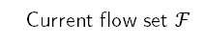
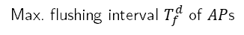
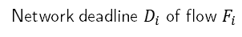
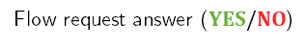
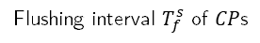
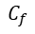
Design parameters
Hardware parameters
Number of slots per round
Deadline ratio
WCETs of Bolt API functions
Length of a round
$$C_{net}$$
$r$
$B$
$$C_{w}$$
$$C_{r}$$
$$C_{f}$$
DRP
Application
requirements
Computes system’s parameters
and
Answer new flow requests
Static output
Flushing interval $T_{f}^{s}$ of $CP$s
Current flow set $ℱ$
Dynamic outputs
New flow request
$F_{i}=\left(n_{i}^{s},n_{i}^{d},T_{i},J_{i},D_{i}\right)$
Max. flushing interval $T_{f}^{d}$ of $AP$s
Network deadline $D_{i}$ of flow $F_{i}$
Flow request answer ($YES/NO$)

Slide 22
LWB
sched_{i}
slot₁
…
slot_{B}
cont.
compute sched.
sched_{i+1}
time
LWB*
sched_{i}
slot₁
…
slot_{B}
fetch
sched_{i+1}
time

Slide 23
Waiting
Schedule fetched
Compute next round schedule
Computing schedule
Next round schedule ready
Ready
Request
processed
Requests
left
No request left
Processing request
Done

Slide 24
AP
IRQ Handler
CP
request
Request queue
schedule?
schedule
Alternating buffer
Ready buffer
Working buffer

Slide 25
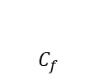
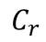

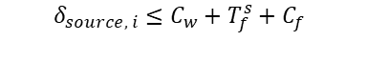
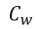
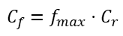
$$δ_{source, i}≤C_{w}+T_{f}^{s}+C_{f}$$
$$C_{w}$$
AP_{s}
$$C_{r}$$
CP_{s}
…
…
time
$$C_{f}=f_{max}⋅C_{r}$$
$$T_{f}^{s}$$
$$C_{f}$$
write operation
read operation

Slide 26
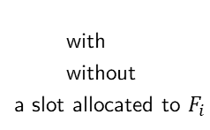
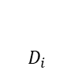
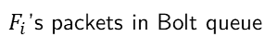
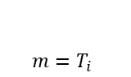
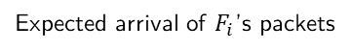
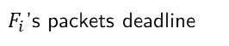
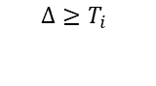
$${Δ≥T}_{i}$$
A
B
AP_{s}
CP_{s}
1
2
$${m=T}_{i}$$
$$D_{i}$$
Network
3
4
5
6
time
$F_{i}$’s packets in Bolt queue
flush operation
Other packets in Bolt queue
Communication rounds
with
without
a slot allocated to $F_{i}$
Expected arrival of $F_{i}$’s packets
k
and
k
$F_{i}$’s packets deadline

Slide 27
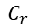
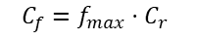

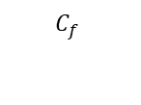
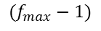
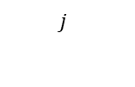
$$(f_{max}−1)$$
$$j$$
“arrival” epoch
without jitter
B’
B
AP_{s}
…
$$C_{r}$$
…
…
time
CP_{s}
$$C_{f}$$
$$C_{f}=f_{max}⋅C_{r}$$
$$T_{f}^{s}$$
write and read operation
packet B’ - With jitter
packet B - Without jitter

Slide 28
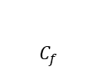

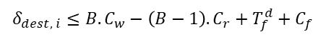
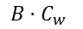
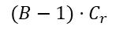
$$δ_{dest, i}≤{B.C}_{w}−\left(B−1\right).C_{r}+T_{f}^{d}+C_{f}$$
…
$$B⋅C_{w}$$
AP_{s}
CP_{s}
…
…
…
time
$$T_{f}^{d}$$
$$C_{f}$$
$$(B−1)⋅C_{r}$$
write operation
read operation

Slide 29
Control missed
Control
received
Control received
Bootstrapping
Running
Control
received
Control missed
Control
missed
Suspended

Slide 30
Baloo
Crystal
Protocol A
ProtocolB
Logic only
Network layer protocol
Middleware
Interface to the radio and HW
ST primitive
Glossy
ST1
ST2
ST3
ST4
Communication Primitives
Drivers
HW
HW1
HW2
HW3
Physical
Data Link
Network

Slide 31
Time-Triggered Wireless (TTW)
TTnet
Glossy
Node
Multi-hop Wireless Network
Node
Node
Host

Slide 32
Rounds
k
sleep
k+1
time
Slots
Beacon
N₂
…
N_{B}
N₂
N_{B}
Glossy floods
Host

Slide 33
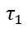
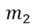
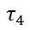
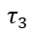

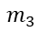
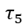
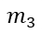
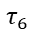
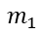
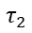
Control computation
Pressure
reading
$$τ_{1}$$
$$m_{1}$$
$$τ_{3}$$
$$m_{3}$$
$$τ_{5}$$
Valve
actuation
Temperature
reading
$$m_{2}$$
$$m_{3}$$
Pump
actuation
$$τ_{2}$$
$$m_{2}$$
$$τ_{4}$$
$$τ_{6}$$
Data storage

Slide 34













Number of messages served
Next hyperperiod
$m_{i}.o$
$m_{i}.p$
$m_{i}.d$
$$af_{i}$$
$$3$$
$$sf_{i}$$
$$2$$
$$df_{i}$$
$$1$$
$$0$$
-$1$
$r_{1}$
$r_{2}$
$r_{3}$
$r_{4}$
$r_{5}$
$r_{1}$
time
$$t=0$$
$$t=0$$

Slide 35




$$m.o$$
$$m.d$$
$τ_{1}$
$m$
$τ_{2}$

Slide 36


$$m.o$$
$$m.d$$
$τ_{1}$
$m$
$τ_{2}$

Slide 37





$$M_{1}$$
$$M_{2}$$
$$M_{3}$$
$$M_{4}$$
$$M_{5}$$
1
2
3
2
4
5
6
1
5
4
5
6

Slide 38






$$a_{1}$$
$τ_{1}^{1}$
$m_{1}$
$τ_{1}^{2}$
$$a_{5}$$
$τ_{5}^{1}$
$m_{5}$
$τ_{5}^{2}$
$$m_{1}$$
$$m_{5}$$
Rounds
Conflict in mode $M_{4}$

Slide 39




$$a_{1}$$
$τ_{1}^{1}$
$m_{1}$
$τ_{1}^{2}$
$$a_{5}$$
$τ_{5}^{1}$
$m_{5}$
$τ_{5}^{2}$
$$m_{1}$$
$$m_{5}$$
Rounds
Reservation of the schedule of $A_{1}$ when scheduling $A_{5}$ in mode $M_{3}$

Slide 40















$$\{1,i,0\}$$
1st signal
2nd signal
$\{3,k,0\}$
$$\{2,k,1\}$$
Mode$M_{i}$
$$1$$
$$2$$
$$3$$
$$4$$
$$5$$
$$1$$
$$2$$
$$3$$
$$4$$
$$5$$
$$1$$
$$t=0$$
$$t=0$$
$$\{6,k,0\}$$
$$t=0$$
Mode $M_{k}$
$$6$$
$$7$$
$$t=0$$

Slide 41





$$M_{1}$$
$$M_{2}$$
$$M_{3}$$
$$M_{4}$$
$$M_{5}$$

Slide 42










$T_{slot}$
$$T_{wake−up}$$
$$T_{start}$$
$$T_{flood}$$
$T_{gap}$
Slot
wake-up
start
listen
R
T
R
T
idle
proc.
Flooding step
delay
cal.
header
payload
$$T_{d}$$
$$T_{cal}$$
$$T_{header}$$
$T_{payload}$
$$T_{hop}$$

